Slide 1
Hydro-sensor and Photosensor IoT Garden Network
Harrison Freund, Vincent Lopez, Jeffery Schnell, Alexandria Ballard

Slide 2
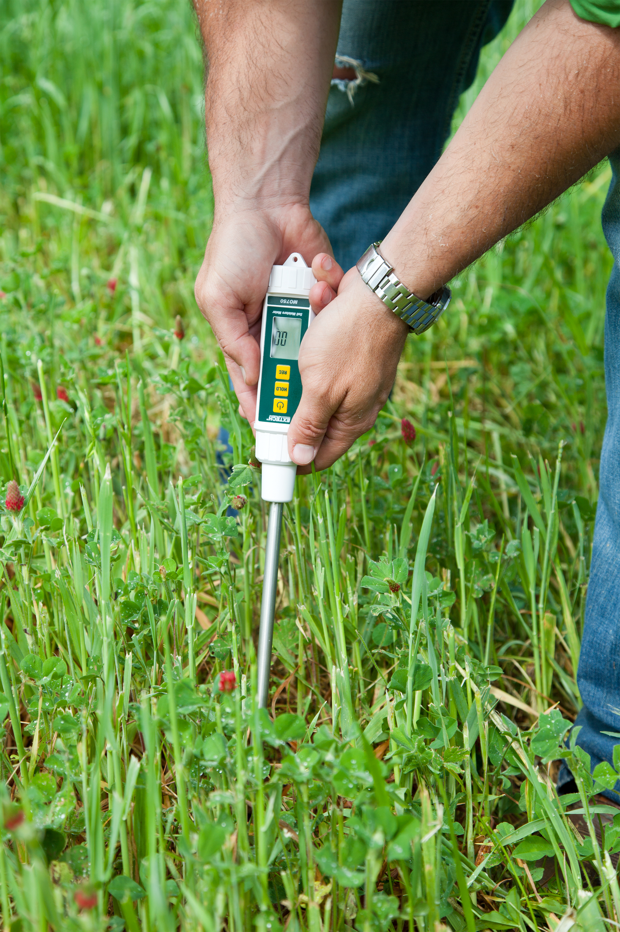
Project Problem
Measuring characteristics of soil involves manual measurement and data recording
Frequency of recording limited to user presence
Recording limited by human error

Slide 3

Project Objective
Provide automated measure
Moisture sensors
Photo sensors
Provide automated archiving
IoT services

Slide 4

Project Management
Communication with client
Slack
Email
Monthly in person meetings
Communication within the team
Slack
In person work sessions

Slide 5


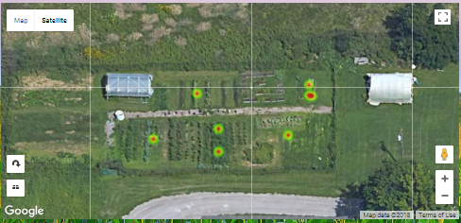
Design Method and Hardware Overview
Arduino Uno Combines data for output to Internet
Raspberry Pi 3 Sends post request to Internet
2.
3.
4.
Arduino Nano Collects and processes data
User Computer Displays data on user website
1.
DIRT DATA

Slide 6
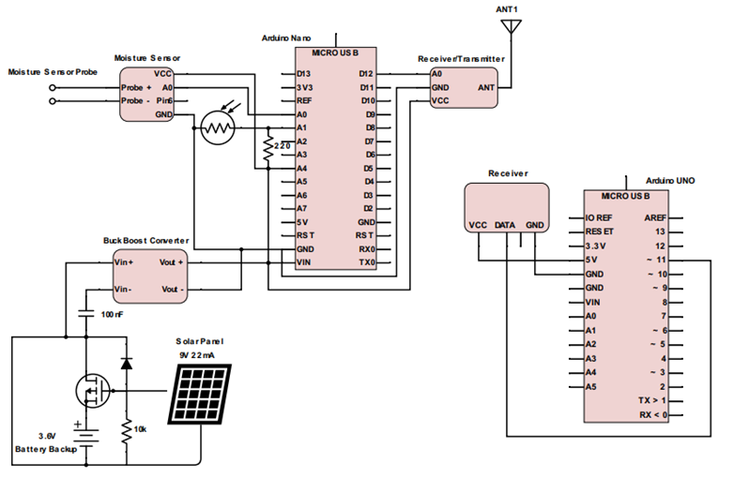
Hardware Circuitry

Slide 7
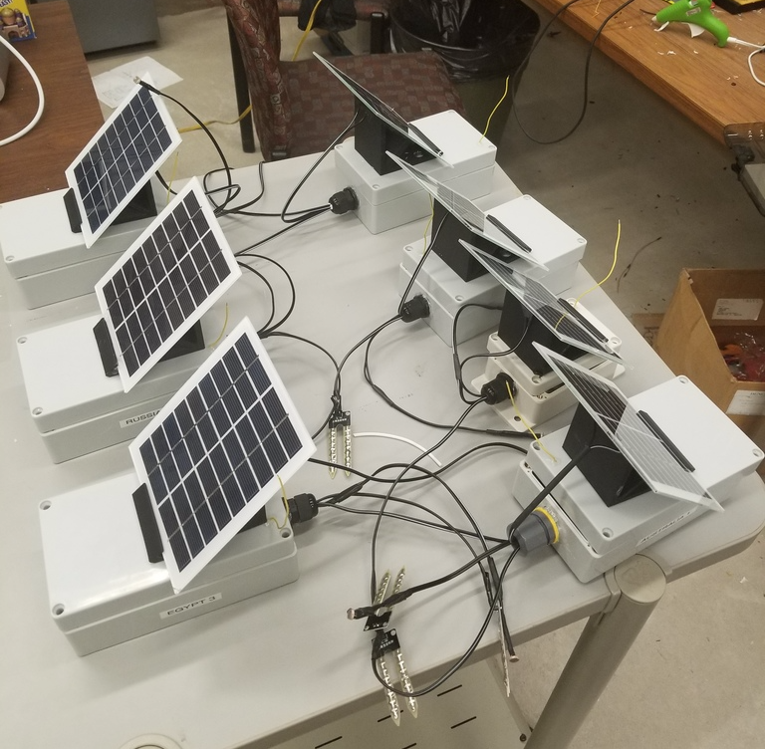
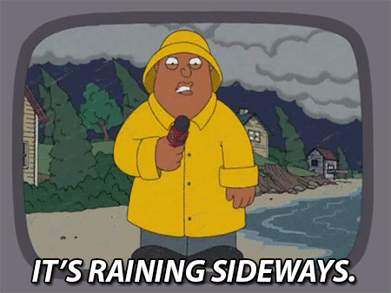
Hardware Durability
Really tested last night

Slide 8
Software in the System
Arduino Uno Combines data for output to Internet
Raspberry Pi 3 Sends post request to Internet
2.
3.
4.
Arduino Nano Collects and processes data
User Computer Displays data on user website
1.
DIRT DATA

Slide 9
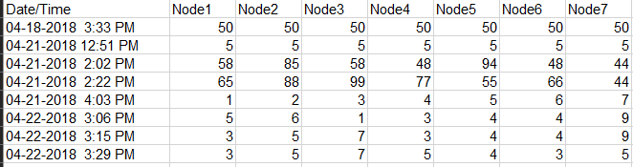
User-side software

Slide 10
Questions

